Slide 1


The Impact of COVID-19 on Parcel Volumes: A Surge Driven by E-Commerce

Slide 2


TEAM
KUSH GADHVI
MODUPE BELLO

Slide 3




Agenda
Introduction of ABC
Mission and Vision
Project
Goals
Market Trend Analysis

Slide 4

ABC Parcel
In a nutshell
ABC launched its delivery services in the early 2000s
Known for reliable service, innovative logistics solutions, and customer focused operations.
ABC Parcel experienced challenges during COVID-19, including capacity and operational strain.
Adapted successfully by expanding delivery infrastructure and enhancing e-commerce partnership.

Slide 5

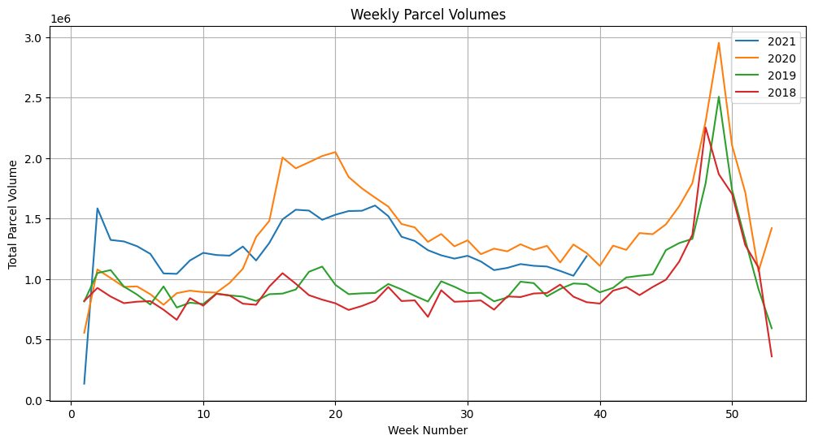
Executive Summary
ABC Parcel Volumes
ABC company’s 2020 parcel volumes trend analysis:
Significant increased compared to 2018 and 2019 years.
Peak season (Weeks 45-50) experienced record-breaking spike, reaching nearly 3 million parcels.

Slide 6
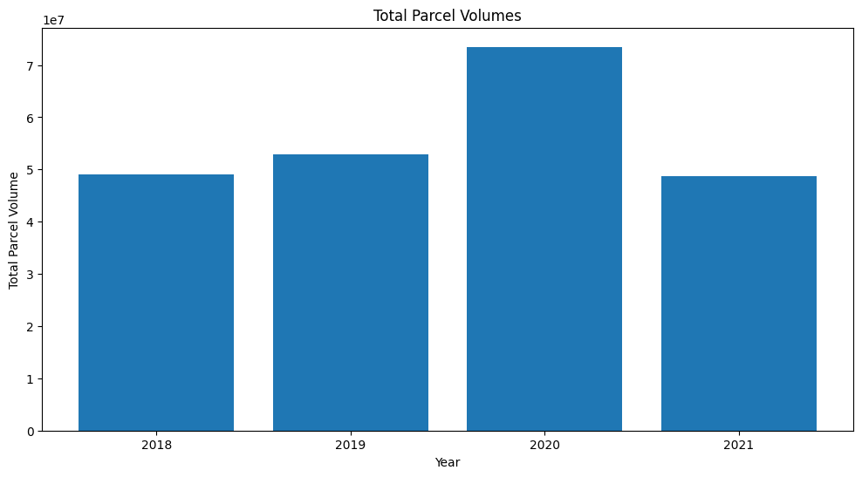
Analyzing the Impact of COVID-19 on ABC Parcel
Key Insights: Growth & Performance
2020 spike reflects pandemic’s impact on parcel deliveries.
2021 shows a dip due to restrictions and in-store shopping

Slide 7
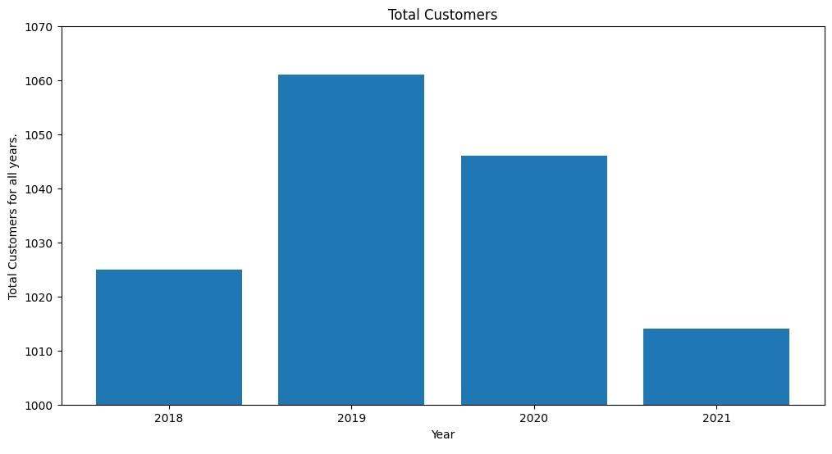
Trends in Customer Growth and Decline: 2018-2021
2018: Total customers around 1025.
2019: Total customers increased to approximately 1060, highest value in observed period.
2020: Customers declined to around 1050 due to COVID-19.
2021: Significant customers drop to approximately 1010, lowest across years due to reduced demand, competition or other factors.

Slide 8
Analyzing The Internal Factors
SWOT ANALYSIS

Slide 9
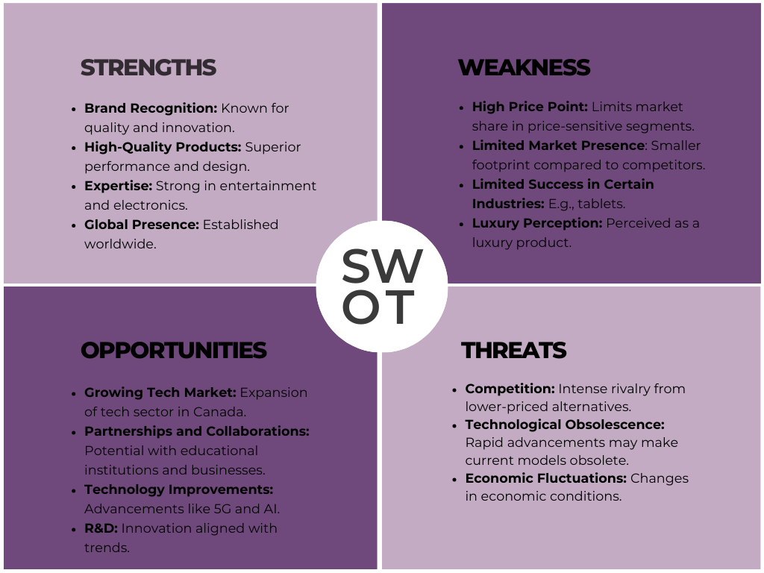


Slide 10

SWOT Based Strategy : Innovation
STRENGTH + OPPORTUNITY

Slide 11
Brand Recognition + Market Penetration: Leverage Sony's brand to penetrate Canada's tech market with VAIO's quality.
Entertainment Expertise + User Satisfaction: Use SONY's entertainment know-how for enhanced user experience.
Financial Stability + Collaborative Promotion: Partner for effective VAIO promotion leveraging Sony's stability.
Strong Marketing + Brand Visibility: Boost VAIO's visibility through strategic marketing in media.
Brand Recognition + Innovative Relaunch: Reintroduce VAIO as a premium, innovative brand.
Government Support + Online Customization: Utilize government support for a personalized online VAIO experience.
SWOT Based Innovation
Strength + Opportunity

Slide 12
Change Management

Slide 13
CHANGE MANAGEMENT
Step 1 | Step 2 | Step 3 | Step 4 | Step 5 | Step 6 | Step 7 | Step 8
As-is Analysis Sony Vaio Laptop Data Acquisition and Analysis of the Customer and Marketing Survey Stakeholder Analysis for the Sony Vaio Laptop | Management Collaboration of the New Sony Vaio Product initiative. Roles assignment for the Sony Vaio Laptop Organize Stakeholder Workshop | Conceptualization of the Sony Laptop Design Change Management Plan for New Sony Vaio Laptop Implementation Plan for New Sony Vaio Laptop | Assign Roles to the stakeholders during implementation process of Sony Vaio Laptop | Conduct interviews, workshops, presentation, skill framework and teambuilding programs to all employees for the Sony Vaio Laptop | Plan and implement workshops to achieve short-term wins for the Sony Vaio | Transfer workshop and project organization for all stakeholders for the initiative. | Evaluate and reinforce the change initiative in organizational culture for Sony Vaio Laptop product.
Initiate |  | Plan | Manage |  |  |  | Reinforce

Slide 14
Balanced Score Card

Slide 15
Balanced Score Card
 | OBJECTIVES | INITIATIVE | TARGET | MEASURE
FINANCIAL | Increase Revenue | Introduce Combos & Promotional Offers | Increase 10% Revenue by Q3 | Sales Analysis
CUSTOMER | Improve product quality Enhance customer service and customer Satisfaction | Extended warranties, Surveys, Support, channels and address feedbacks | ↑85 % Customer Satisfaction rating, NPS of 8 by Q2 | Customer Satisfaction Score, Net Promoter Score

Slide 16
Balanced Score Card..part2
 | OBJECTIVES | INITIATIVE | TARGET | MEASURE
INTERNAL PROCESS | Reduce production lead times | Implement Lean Six Sigma Manufacturing techniques | 10% lead time reduction by Q2 | Measure average time from order to delivery
 | Reduce Customer Complaints | • Implement a robust customer feedback system. • Improve product quality. | Reduce customer complaints by 15% by the end of Q2 | Number of customer complaints received. Customer Satisfaction Score (CSS).
 | Introduce New Laptop Solutions | • Develop new laptop models with advanced features. • Research on emerging technologies and user needs. | Launch 3 new laptop models by the end of Q4. | Number of new laptop models introduced. Customer feedback and reviews on the new laptop Models
ORGANIZATIONAL CAPACITY | Optimization and automation training | Partnership with universities/online to train staff in production automation | All production staff certified in production automation by Q2 | Employee Skill Evaluation
 | Train staff for Complaint analysis | Process to study and resolve customer complaints | 7% reduction in customer complaints by Q2 | service Desk Reports
 | Train Skilled Resources in AI application | Partnership with Universities and online schools in AI applications | Upskill 70% staff in AI application by Q2 | Employee Skill Evaluation in AI application
 | Increase research and development | Invest $500,000 in R&D | Increase the number of active R&D projects by 20% by Q4 | Number of new technologies or products developed. Amount of investment utilized in R&D.

Slide 17
Strategy Map

Slide 18
Strategy Map
Financial
Customer
Process
Organizational
Reduce Cost
Increase Profit
Increase Revenue
Customer Satisfaction
New customers
Production Optimization and Automation
Complaint Analysis
Innovate new laptop solutions
Automation Technology training
Complaint Analysis Training
Skilled resources Training in AI application
R&D investment in AI training

Slide 19
Request For Proposal

Slide 20
Request for Proposal
PURPOSE: Sony Vaio seeks high-quality hardware vendors for laptop integration to maintain its commitment to innovative computing solutions.
BACKGROUND:
Focus: Providing cutting-edge technology solutions to higher education institutions.
Resources: Extensive research and economic partnerships strengthen its position.
GOALS:
Objective: Collaborate with vendors for essential hardware components.
Outcome: Enhance the quality and performance of Sony Vaio laptops.
Target: Meet evolving needs of institutional clients and affiliates.

Slide 21
Product Roadmap

Slide 22




